Slide 1
Informal Resolution Facilitator Training
2022

Slide 2
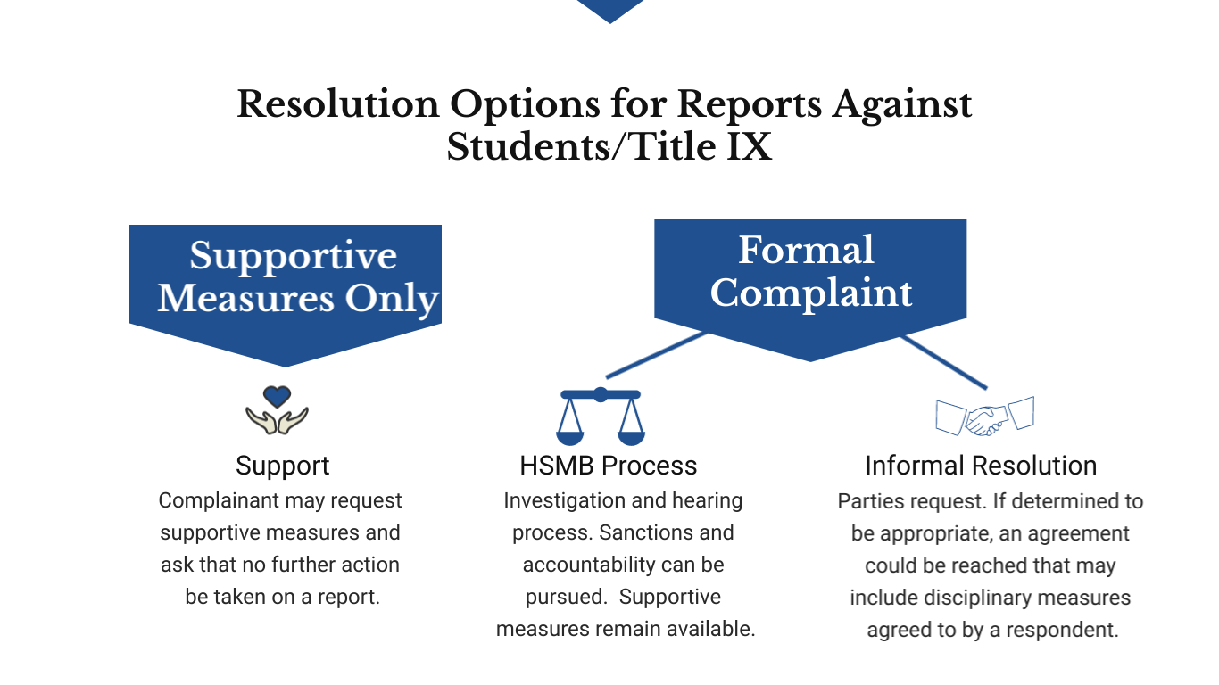
Resolution Options for Reports Against Students/Title IX

Slide 3
Requirements of Informal Resolution
Alternative to the investigation and HSMB process
Formal complaint
Written notice to the parties
Parties’ voluntary, written consent to participate
Not permitted to resolve allegations an employee sexually harassed a student

Slide 4
Informal Resolution can begin anytime before hearing
Common off-ramps from formal to informal resolution
Report meeting/intake with Complainant
First meeting with Respondent
After reviewing investigation materials
After reviewing investigation report

Slide 5
May not be appropriate if:
University must agree to informal resolution and can end informal resolution any time prior to a final agreement
History of violence between parties
Power imbalances that cannot be offset with support measures
Conditions that could create unsafe environment
Party/parties not acting in good faith
Agreed resolution would not meet Title IX office goals

Slide 6
Types of informal resolution
All parties engage in direct conversation about the incident with the assistance of facilitator
Facilitated Conversation
Most common
Facilitator acts as go-between for parties to determine resolution
May include some aspects of facilitated conversation and restorative justice
Shuttle Diplomacy
Identifying harm, taking accountability for the harm, and determining how best to repair the harm. Respondent must take accountability for causing harm.
Restorative Justice

Slide 7
Potential Benefits
Can address policy violations and non-policy violations
Gives students more control over process and outcome
Allows for creative processes and solutions that are tailored and individualized
Allows for support and accountability
Acknowledges and appreciates that our students are learners
Is not trauma inducing, maybe trauma healing
Goals
Restoring educational access
Empowering choice and agency over resolution
Identifying, and to the extent possible, addressing participants’ needs
Addressing past harm
Preventing future harm
Space for communication and understanding, when desired
Safety

Slide 8
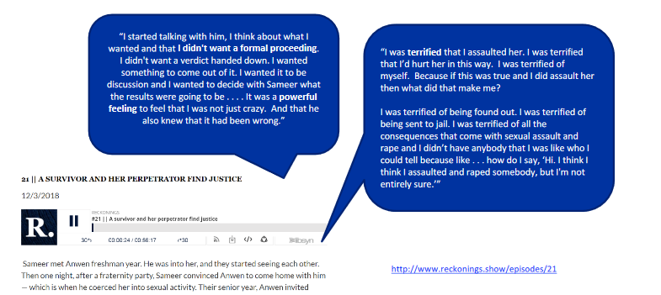
A survivor and Her Perpetrator Find Justice

Slide 9
Facilitator requirements
Neutral
Free from conflicts of interest and bias (against complainants or respondents generally or an individual Complainant or Respondent)
Must serve impartially without prejudging facts at issue
Center participant needs
Active listener
Seeks to understand
No assumptions

Slide 10
Personality strengths
Communication Strengths
Tolerant
Thoughtful
Practical
Collaborative
Respectful
Empathetic
Intuitive
Self-Aware
Creative
Non-Judgmental
Open-Minded
Credible
Characterize but don’t criticize
Clarity
Emotional control
Eye contact
Relaxed tone
Avoid negative body language
Avoid negative verbal or facial reactions

Slide 11
Facilitator Role
Ensures an equitable and fair process
Allows each party to feel empowered and heard
Encourages and guides meaningful dialogue between parties
Helps uncover parties’ underlying needs and interests

Slide 12
Advisors
Advisors of choice are permitted in the informal resolution process
Can attend meetings. Advisors do not generally have a speaking role in meetings.

Slide 13
Intake Process
Informal Facilitator Role
Ascertain motivation for pursuing informal resolution
Determine positions, interests, and needs
Ascertain goals and which resolution method is most likely to meet goals
Manage expectations
What occurred from their perspective

Slide 14
Positions, Interests, Needs
Specific demands, a chosen stance, a solution a party has decided upon—most parties start with positions
Positions
Underlying motivations, hopes, concerns, desires, worries that led to position
Interests
What party actually must have
Needs

Slide 15
Positions, Interests, Needs

Slide 16
Potential Process
Sample of Shuttle Diplomacy
Meet with Complainant—identify interests, identify possible solutions, prepare any message to other party
Ex. “What, if anything, would you like me to tell him/her/them about how you are feeling?
Ex. “What, if anything, do you want me to say to him/her/them about the fear you continue to have?”
Ex. “Is there anything that could be done right now that would help meet your needs?”
Ex. “What would you like to see Respondent do to repair the harm to you?”
Meet with Respondent—identify interests, identify possible solutions, share information from Complainant, prepare message to Complainant
Meet with parties to continue to generate and test solutions
Develop an agreement and review with parties
Parties sign agreement, or process referred back to Title IX Coordinator

Slide 17
Voluntary Meetings Between Offender and Harmed Party

Slide 18
Restorative Justice
Questions for Complainant
What happened?
What impact did this incident have on you?
What was the hardest thing about this?
If the person responsible were here, what would you like to say to them or ask them?
Is there anything that could be done right now that would help meet your needs?
Are there things in this community that permit/encourage incidents like this to happen that you would like to see addressed?
What would you like to see Respondent do to repair the harm they have caused you?
What concerns do you have about participating in this process?

Slide 19
Restorative Justice
Questions for Respondent
What happened from your perspective
At the time of the incident, what were you thinking about?
What have you thought about since the incident?
What impact has this incident had on you?
Who else has been impacted? How?
What do you think you could have done differently?
What can you do to make things right?
Are there things in this community that permit/encourage incidents like this to happen that you would like to see addressed?
What concerns do you have about participating in this process?

Slide 20
Reaching Agreement
Some Possible Resolutions
Alter class schedules
Alter extra-curricular activities
Compl. provide impact statement with reflection/follow up discussion session
Education sessions
Check-ins with Title IX Coordinator
Community Service
Written/spoken apology
Change in housing
Restrictions on access to various locations
Voluntary temporary or permanent withdrawal
Restriction from participation in activities
Counseling Sessions

Slide 21
Reaching Agreement
Facilitator Considerations for Proposed Agreement
Is agreement clear?
Do parties understand and feel comfortable with all provisions?
Can it be enforced? (do parties understand limits on ability to enforce?)
What disclosures of the agreement will need to be made to enforce?
Consider giving parties time to consider the proposed agreement; helpful to set a deadline for this consideration period.
Can continue to facilitate discussion over terms.

Slide 22
Title IX Definitions and Process

Slide 23
Is Sexual Misconduct Title IX or Non-Title IX?

Slide 24
University program or activity
(1) Locations, events, or circumstances over which the University exercises substantial control over both the respondent and the context in which the conduct occurs, and (2) also includes any building owned or controlled by a student organization that is officially recognized by the University

Slide 25
University program or activity off-campus examples
University Program or Activity
Not University Program or Activity
Law School Pig Roast (all day event; 3Ls spend the night at house)
Fraternity/Sorority Formal where organization rents a space for the event
Student party at Windfall Hill/Pole Houses
Notes:
Fact-specific inquiry in most cases, but some general examples

Slide 26
Policy definitions
Our Policy
Title IX
Nonconsensual Sexual Penetration
Nonconsensual Sexual Contact
Stalking
Dating and Domestic Violence
Sexual Exploitation
Non Title IX Sexual Harassment
Sexual Discrimination
Nonconsensual Sexual Penetration
Nonconsensual Sexual Contact
Stalking (based on sex)
Dating and Domestic Violence
Title IX Sexual Harassment
Incest
Statutory Nonconsensual Sexual Penetration

Slide 27
Title ix sexual harassment
Title IX sexual harassment means conduct on the basis of sex that occurs in a University education program or activity, against a person in the United States, and satisfies one or more of the following:
A University employee conditioning the provision of an aid, benefit, or service of the University on an individual’s participation in unwelcome sexual conduct;
Unwelcome conduct determined by a reasonable person to be so severe, pervasive, and objectively offensive that it effectively denies a person equal access to the University’s education program or activity;
Nonconsensual Sexual Penetration;
Nonconsensual Sexual Contact;
Incest;
Statutory Nonconsensual Sexual Penetration;
Dating violence;
Domestic violence; and/or
Stalking.

Slide 28
Nonconsensual sexual penetration
Nonconsensual sexual penetration means penetration, no matter how slight, of the vagina or anus with any body part or object, or oral penetration by a sex organ of another person, without consent.

Slide 29
Nonconsensual sexual contact
Nonconsensual sexual contact means the touching of the private body parts of another person, either under or over clothing, for the purpose of sexual gratification without consent. Private body parts include breasts, genitals, mouth, and buttocks.

Slide 30
Nonconsensual sexual contact
Nonconsensual sexual contact means the (1) touching of the private body parts of another person, either under or over clothing, for the (3) purpose of sexual gratification (4) without consent. Private body parts include (2) breasts, genitals, mouth, and buttocks.

Slide 31
Consent
Mutually understandable words and/or actions that clearly indicate a willingness to engage freely in sexual activity.

Slide 32
Consent
Not present if obtained by force, coercion, or when Complainant is incapacitated

Slide 33
Consent: Force
Use or threat of physical violence or intimidation to overcome an individual's freedom of will to choose whether or not to participate in sexual activity.

Slide 34
Consent: Coercion
Unreasonable and persistent pressure to compel another individual to initiate or continue sexual activity against an individual's will.
A person's words or conduct are sufficient to constitute coercion if they wrongfully impair another individual's freedom of will and ability to choose whether or not to engage in sexual activity.
In evaluating coercion, consider: (1) frequency of the application of pressure; (2) intensity of the pressure; (3) isolation of the person being pressured; and (4) duration of the pressure.

Slide 35
Consent: incapacitation
Mentally and/or physically helpless, asleep, unconscious, or unaware that sexual activity is occurring.

Slide 36
Consent: Incapacitation
Was complainant incapacitated?
If so, did the respondent know that the complainant was incapacitated?
If not, would a sober, reasonable person in the same situation have known that the complainant was incapacitated based on objectively and reasonably apparent indications of impairment.
Notes:
Flow chart showing questions regarding incapacitation: (1) was complainant incapacitated? (2) if so, did the respondent know that the complainant was incapacitated? (3) if not, would a sober, reasonable person in the same situation have known that the complainant was incapacitated based on objectively and reasonably apparent indications of impairment?

Slide 37
Stalking
Stalking means engaging in a course of conduct directed at a specific person that would cause a reasonable person to:
Fear for the person's safety or the safety of others; or
Suffer substantial emotional distress.

Slide 38
Course of conduct
Two or more acts, including, but not limited to, acts in which the alleged stalker directly, indirectly, or through third parties, by any action, method, device, or means, follows, monitors, observes, surveils, threatens, or communicates to or about a person, or interferes with a person's property.

Slide 39
Dating and domestic violence
Violence committed by…
A current or former spouse or intimate partner of the complainant;
A person with whom the complainant shares a child in common;
A person who is cohabitating with or has cohabitated with the complainant as a spouse or intimate partner; or
Any other person against a complainant who is protected from that person's acts under the domestic or family violence laws of Virginia (18.2-572, 18.2-61 et seq.), which includes parents, stepparents, children, stepchildren, brothers, sisters, half-brothers, half-sisters, grandparents, grandchildren, and in-laws.
Who is or has been in a social relationship of a romantic or intimate nature with the complainant; and
Where the existence of such a relationship shall be determined based on (1) the length of the relationship; (2) the type of relationship; and (3) the frequency of interaction between the persons involved in the relationship.

Slide 40
Dating and domestic violence
Domestic and/or dating violence includes sexual or physical violence or the threat of that violence

Slide 41
Sexual harassment
Policy
Title IX
Unwelcome conduct of a sexual nature or unwelcome conduct based on sex, sexual orientation, gender identity, or gender expression, when one or more of the following conditions are present:
Quid Pro Quo
The unwelcome conduct is so severe, persistent, or pervasive that it unreasonably interferes with an individual's work or academic performance, or creates an intimidating or hostile academic or work environment under both an objective and subjective standard.
Quid Pro Quo (employees only)
Unwelcome conduct based on sex determined by a reasonable person to be so severe, pervasive, and objectively offensive that it effectively denies a person equal access to the University’s education program or activity

Slide 42
Sexual harassment
Policy
Title IX
Unwelcome conduct of a sexual nature or unwelcome conduct based on sex, sexual orientation, gender identity, or gender expression, when one or more of the following conditions are present:
Quid Pro Quo
The unwelcome conduct is so severe, persistent, or pervasive that it unreasonably interferes with an individual's work or academic performance, or creates an intimidating or hostile academic or work environment under both an objective and subjective standard.
Quid Pro Quo (employees only)
Unwelcome conduct on the basis of sex determined by a reasonable person to be so severe, pervasive, and objectively offensive that it effectively denies a person equal access to the University’s education program or activity

Slide 43
Title IX Sexual Harassment: on the Basis of sex
Where conduct is sexual in nature, or where conduct references one sex or another, that suffices to constitute conduct “on the basis of sex.”

Slide 44
Title IX sexual harassment
Whether conduct is unwelcome is subjective inquiry
Severity/Pervasiveness is objective inquiry from the perspective of a reasonable person in the complainant’s position.

Slide 45
Title IX Harassment: types of behavior evaluated under harassment standard
Physical touching, not under nonconsensual sexual contact (hugging, rubbing against someone, patting, pinching)
Exposing oneself
Verbal harassment
Sexual exploitation

Slide 46
Title IX Sexual Harassment: Examples in Preamble
“Disseminating ‘revenge porn,’ or conspiring to sexually harass people (such as fraternity members telling new pledges to ‘score’), or other unwelcome conduct that harms and humiliates a person on the basis of sex may meet the elements of the Davis standard including pervasiveness, particularly where the unwelcome sex-based conduct involves widespread dissemination of offensive material or multiple people agreeing to potentially victimize others and taking steps in furtherance of the agreement.”

Slide 47
Title IX Sexual Harassment: Deprive Equal access
Does not require that a complainant has already suffered loss of education
Does not require that a person’s total or entire educational access has been denied
Evaluate whether Complainant deprived of equal access, measured against the access of a person who has not been subjected to the sexual harassment.
Based on reasonable person standard

Slide 48
Title IX Sexual Harassment: Deprive Equal access
Examples (no specific type of reaction/concrete injury required):
Wrestler who quits the team but carries on with other school activities
Student who attends school, but begins experiencing anxiety symptoms
Skipping class to avoid a harasser
Decline in grade point average
Difficulty concentrating in class

Slide 49
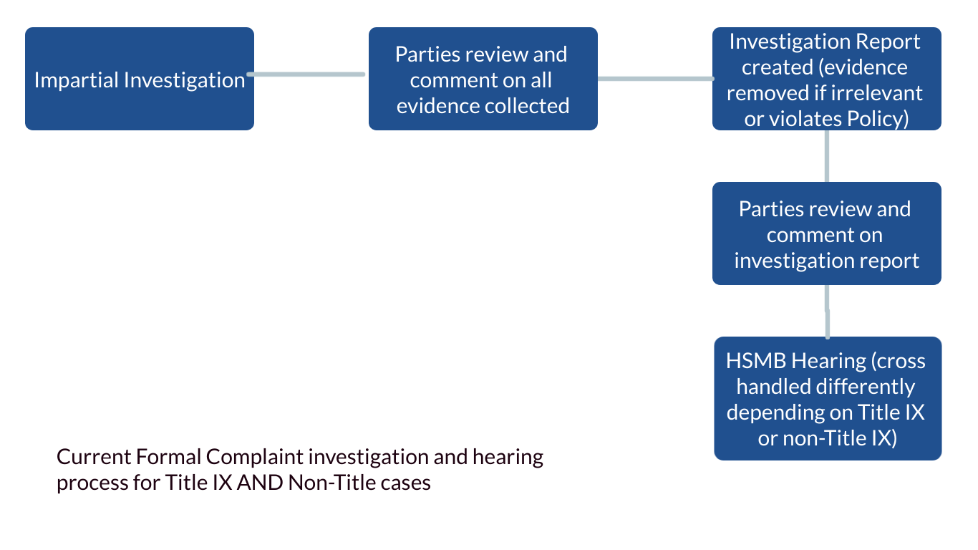
Current Formal Complaint Investigation and Hearing Process for Title IX AND Non-Title Cases

