Slide 1

Informal facilitator and investigators
January 10, 2024

Slide 2

Discussion
Scheduling with shuttle diplomacy
Dealing with difficult parties/advisors and the role of the advisor
Mediation vs informal resolution
Role of the facilitator

Slide 3

Steps of shuttle agreement
Meet individually with each party to discuss process, ground rules, format, needs
Schedule resolution session: all parties/advisors present in separate rooms.
If general terms agreed to through session, informal facilitator creates draft agreement and circulates to parties. If no agreement on general terms at session, either schedule another session or end IR
This Photo by Unknown Author is licensed under CC BY
Finalize specific terms of the agreement (another session can be scheduled if needed).

Slide 4
Discussion
Scheduling with shuttle diplomacy
Dealing with difficult parties/advisors and the role of the advisor
Mediation vs informal resolution
Role of the facilitator

Slide 5
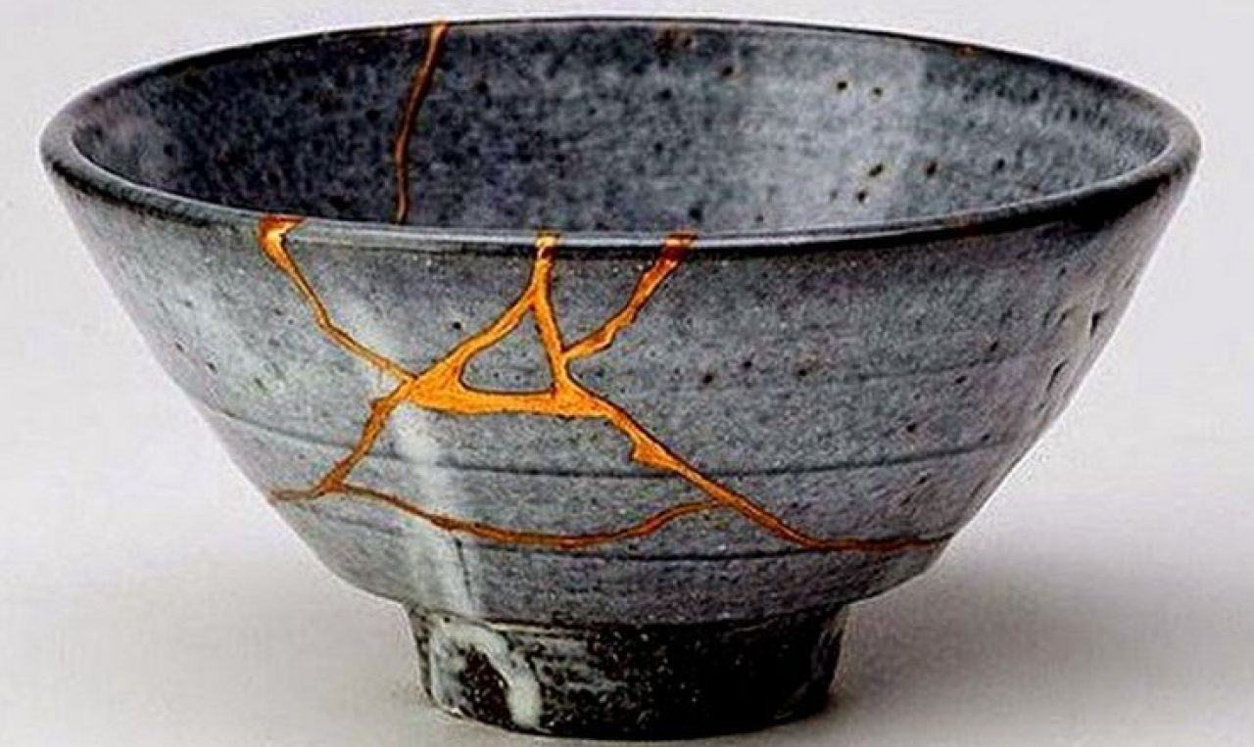
Restorative Justice
This Photo by Unknown Author is licensed under CC BY-SA
This Photo by Unknown Author is licensed under CC BY-SA-NC
“RJ invites a shift in focus from what policy was broken to what harm was done…We seek to understand the harm—who was harmed and in what ways? What needs to they now have, and how might their harm be repaired and their needs met?...The focus is on the harmed party.”
Applying Restorative Justice to Campus Sexual Misconduct: A Guide to Emerging Practices

Slide 6
Mediation vs Restorative Justice
Mediation
Restorative Justice

Slide 7

Justice Needs
Contribute input into key decisions and remain informed about their case
Receive response with minimal delay
According to SVs, satisfying their justice needs rests on the extent to which they:
Tell their story without interruption by adversarial and sometimes hostile questioning
Receive validation
Shape a resolution that meets their material and emotional needs and feel safe
Kass, 2010

Slide 8
Essential Elements
Respondents:
Take responsibility for causing harm
Participate in good faith, with an aim to address the harm caused
Work actively to repair that harm
Consider short, medium, and long-term commitments that might be required
Institutional
Model accountability by acknowledging imperfection of the process
Address issues and challenges as they arise
Create opportunities for feedback within a process
Be alert to unintended consequences, and act to correct them to reduce harm
Eerkes, D., Ketwaroo-Green, J., Pearson, S., Reid, B., Hackett, C.,
Juurlink, I., Martin, L., Scanlon, S., & Bokma, S. (2021). Essential
Elements for Non-Punitive Accountability: a Workbook for Understanding
Alternative Responses to Campus Gender-Based Violence. Courage to Act:
Addressing and Preventing Gender-Based Violence at Post-Secondary
Institutions in Canada.

Slide 9
Questions for Complainant: Harms→Needs→Solutions
Identify Harms
What happened?
What impact did this have on you?
Clarify Needs
Because of this harm, do you have a need for…?
Action Steps
What can be done to meet this need?
What else?
What had been the hardest thing for you?

Slide 10
Questions for Respondent
What happened?
What were you thinking at the time?
What have you thought about since the incident?
Who do you think has been affected by your actions?
What do you think you need to do to make things right?

Slide 11
Discussion
Scheduling with shuttle diplomacy
Dealing with difficult parties/advisors and the role of the advisor
Mediation vs informal resolution
Role of the facilitator

Slide 12
Scenario 1
Fatima filed a formal sexual violence policy complaint against Cameron, a student who worked in the same lab. Informal resolution was pursued. Fatima wrote an impact statement, and requested as a remedy that Cameron read an impact statement back to her so that he could understand how the assault affected her. The administration set it up as an online meeting. A member of the conduct office attended as a support person for Cameron, and a member of the sexual violence response team was a support for Fatima. When Cameron read the statement to her, he did so in a flat voice, finishing by pointing out a few typos in the statement. When finished, he asked, “Are we done here?” Fatima agreed to end the meeting, but she spent the next hour debriefing with her support person and stated that this resolution was not what she wanted.
What steps of a process were skipped in this case?
Could this request have been handled differently to meet the needs of the survivor? How might that have affected the outcome?
What power dynamics exist in this scenario?
Eerkes, D., Ketwaroo-Green, J., Pearson, S., Reid, B., Hackett, C.,
Juurlink, I., Martin, L., Scanlon, S., & Bokma, S. (2021). Essential
Elements for Non-Punitive Accountability: a Workbook for Understanding
Alternative Responses to Campus Gender-Based Violence. Courage to Act:
Addressing and Preventing Gender-Based Violence at Post-Secondary
Institutions in Canada.

Slide 13
Scenario 2
Lou (they/them) is a first-year student living in residence. They had a great first semester, forming a close-knit social group with the others on the floor. Then one night at a party, a floormate and close friend of Lou’s tried to put his hand in their pants while the two of them were dancing. Lou reacted strongly, pushing the person away and yelling at them to “get away.” The rest of the group witnessed the incident, and over the next few weeks, many formed conflicting opinions about who did what, whose fault it was, and what should be done about it.
Lou became more and more uncomfortable living in that environment. They didn’t necessarily want the other student to be punished for what they did, but also wanted them to acknowledge that it was wrong and understand why it was so hurtful. Lou believed that making a complaint under the code of conduct would only make things worse and would do nothing to address the rumours continuing on the floor. They also did not want to move to another residence, but felt responsible for the rift that was forming among their formerly tight group of friends and felt harmed by the rumours as well as the initial incident.
How might informal resolution be used in this situation?
How could it be approached to meet the goals of the parties?
Eerkes, D., Ketwaroo-Green, J., Pearson, S., Reid, B., Hackett, C.,
Juurlink, I., Martin, L., Scanlon, S., & Bokma, S. (2021). Essential
Elements for Non-Punitive Accountability: a Workbook for Understanding
Alternative Responses to Campus Gender-Based Violence. Courage to Act:
Addressing and Preventing Gender-Based Violence at Post-Secondary
Institutions in Canada.

Slide 14
Investigators

Slide 15
Agenda
Notice requirements—checking in regarding notice
Pattern evidence
Incapacitation review
Investigation report drafting
  Writing tips
  Structure/sections
  Use of charts

Slide 16
Review of Investigation Requirements
Formal Complaint | Notice of Allegations | Investigation | Evidence Review | Written Responses to Evidence | Investigative Report | Written Responses to Report
Filed by Complainant or signed by Title IX Coordinator | With sufficient detail and time for a party to prepare for an initial interview | Thorough search for relevant facts and evidence | Of any evidence that is directly related to the allegations | 10-day review period. Parties may submit written response | Fairly summarize relevant evidence. Includes inculpatory and exculpatory evidence | 10-day review period Parties may submit written response

Slide 17
Checkpoints for Additional policy Violations/
Title IX Mandatory Dismissal
Post Complainant interview
Post Respondent interview
Post evidence review and response

Slide 18
Other Reports of Misconduct
Regulations do not prohibit the use of prior or subsequent misconduct, so permitted if relevant.
May be relevant to demonstrate:
  Intent/knowledge/state of mind
  Motive
  Opportunity
  Lack of mistake
  Pattern
  Identity

Slide 19
Incapacitation: Get Detailed Information
Timeframe Complainant consumed alcohol
Number of drinks
For each drink:
  Type
  Mixed? Who mixed it?
  How was it served?
List of others present and when they were there
Any drugs consumed?

Slide 20
Incapacitation: Get Detailed Information
Additional factors that can affect impact of alcohol
  Food consumed (was it normal or abnormal for person)
  Height and weight
  Medications taken that night
  Different sleep patterns than normal
  Illness
  Hydration level
  History of blackouts

Slide 21
Incapacitation: Get Detailed Information
Complainant’s internal experience of own intoxication
  The bookends of memory
  Physical impairments
  Cognitive impairments
  Verbal impairments
  Any other effects?

Slide 22
Incapacitation: Get Detailed Information
Other individual’s observations:
  Observations of Complainant’s consumption
  Physical impairments?
  Cognitive impairments?
  Verbal impairments?
  Other effects?
  Other information to establish timeline
  Knowledge of Complainant’s sober behavior
Text/social media messages sent before, during, and after incident

Slide 23
Incapacitation: Get Detailed Information
May need to frame questions related to alcohol/drug consumption

Slide 24
Incapacitation: Get Detailed Information
Respondent’s knowledge must be explored
  Did Respondent see complainant ingest alcohol or drugs
  How long was Respondent around Complainant? What behaviors did witnesses report during this time?
  Told about alcohol or drugs used by Complainant?
  Did Respondent assist the Complainant in any actions
  Did Respondent make any comments to others about Complainant’s intoxication?

Slide 25
Writing a Report
Remember your audience—telling story to someone with no background in the case.
Writing Fundamentals apply
  Simplicity
  Active voice
  Consistency in tense
  Neutral language
  Use headings, bullets, and charts
  Consistency in terminology
  Precise

